Slide 1
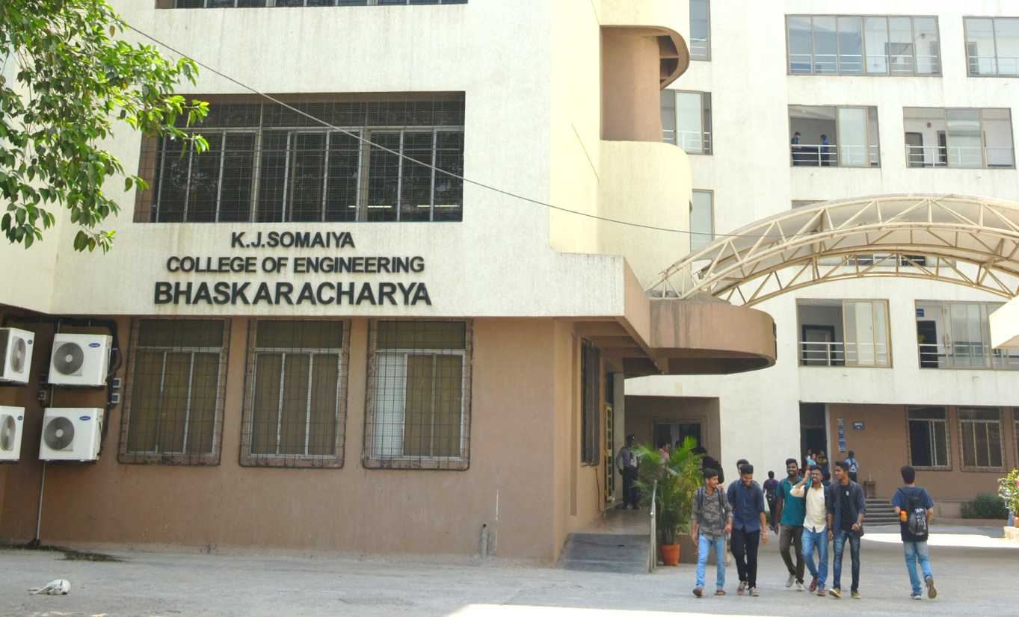
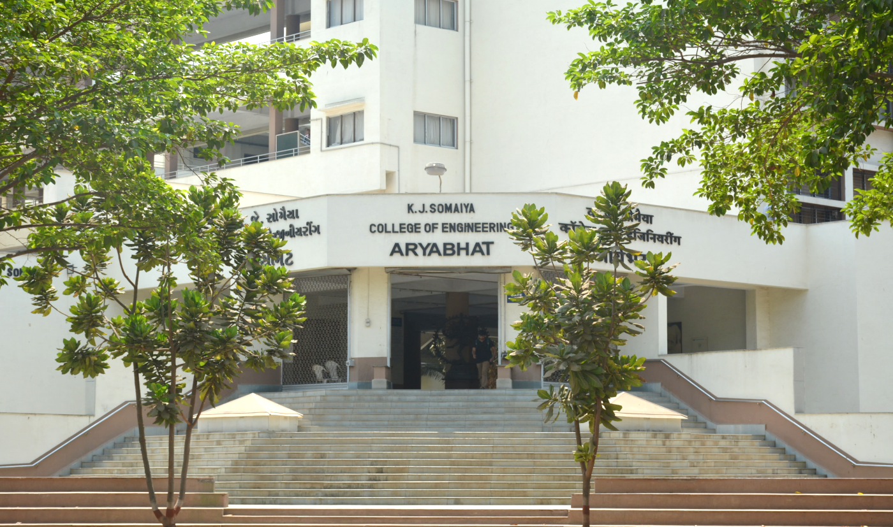
Title
Name of Presenter
Affiliation

Slide 2
Title
Smart Water Management
Data Management
By
Siddhant Shukla
And
Shweta Karandikar
(Department of Computer Engineering)

Slide 3
What is Data Management?
It is the process of collecting, organizing, storing, and manipulating data in a way that allows for easy access, retrieval, and use of that data. It involves various activities aimed at ensuring data quality, security, and availability for decision-making and analysis.

Slide 4
How Does Data Management Helps in Smart Water Management ?
Real-time Monitoring
Sensor Integration
Leak Detection and Prevention
Demand Forecasting
Asset Management
Water Quality Management
Resource Allocation
Customer Engagement
Regulatory Compliance
Flood and Disaster Management
Integration with IoT and AI
Historical Analysis and Reporting

Slide 5
drought_management\Drought Management.html

